Slide 1

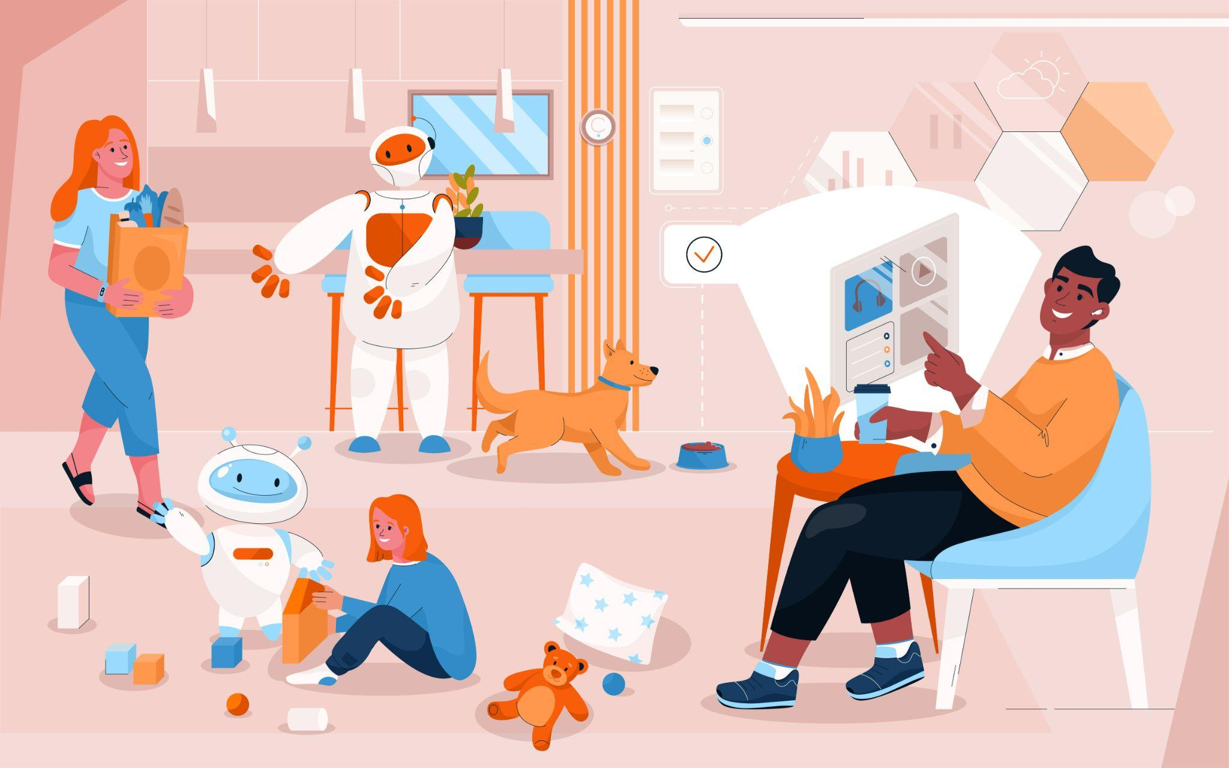

Module 1.1
Course Overview & 5 Big Ideas in AI
Living and Working with Artificial Intelligence
Unit 1
Autonomous Robots
& Self-Driving Cars
Developed for the AI4GA (Artificial Intelligence for Georgia) project funded by National Science Foundation awards DRL-2049029 and DRL-2048502.
This work is licensed under the Creative Commons. Attribution-NonComercial-ShareAlike 4.0 International License. https://creativecommons.org/licenses/by-nc-sa/4.0/

Slide 2

Module 1.2 (A)
Autonomous Robots: Robot or Not
Living and Working with Artificial Intelligence
Inspired by the AI or Not Activity developed by MIT. Robot ot Not Activity developed for the AI4GA (Artificial Intelligence for Georgia) project funded by National Science Foundation awards DRL-2049029 and DRL-2048502.
This work is licensed under the Creative Commons. Attribution-NonComercial-ShareAlike 4.0 International License. https://creativecommons.org/licenses/by-nc-sa/4.0/
This work is licensed under the Creative Commons. Attribution-NonComercial-ShareAlike 4.0 International License. https://creativecommons.org/licenses/by-nc-sa/4.0/

Slide 3
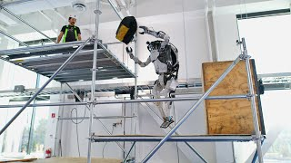
Module 1.2 (B)
Autonomous Robots: Robot Videos
Living and Working with Artificial Intelligence
Developed for the AI4GA (Artificial Intelligence for Georgia) project funded by National Science Foundation awards DRL-2049029 and DRL-2048502.
This work is licensed under the Creative Commons. Attribution-NonComercial-ShareAlike 4.0 International License. https://creativecommons.org/licenses/by-nc-sa/4.0/

Slide 4
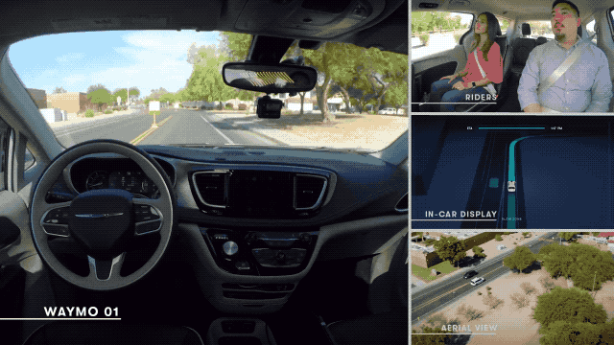
Module 1.3
Anatomy of Self-Driving Vehicles & Applications
Living and Working with Artificial Intelligence
Source: TechCrunch - Darrell Etherington
Developed for the AI4GA (Artificial Intelligence for Georgia) project funded by National Science Foundation awards DRL-2049029 and DRL-2048502.
This work is licensed under the Creative Commons. Attribution-NonComercial-ShareAlike 4.0 International License. https://creativecommons.org/licenses/by-nc-sa/4.0/

Slide 5
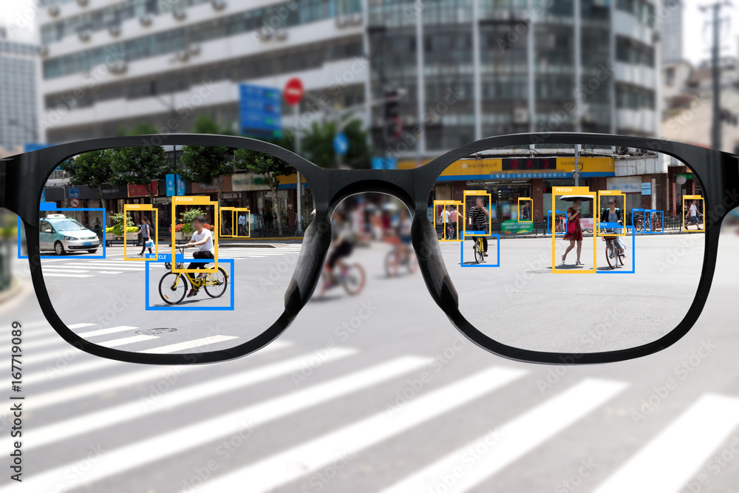
Module 1.4
Robot & Computer Perception
Living and Working with Artificial Intelligence
Licensed from Adobe Stock Images
Developed for the AI4GA (Artificial Intelligence for Georgia) project funded by National Science Foundation awards DRL-2049029 and DRL-2048502.
This work is licensed under the Creative Commons. Attribution-NonComercial-ShareAlike 4.0 International License. https://creativecommons.org/licenses/by-nc-sa/4.0/

Slide 6


Module 1.4
Scratch Face Filter Activity
Living and Working with Artificial Intelligence
Source: Scratch Face Sensing Lab
Face Filter Activity adapted from the starter project available from the Scratch Face Sensing Lab https://lab.scratch.mit.edu/face/. Activity developed for the AI4GA (Artificial Intelligence for Georgia) project funded by National Science Foundation awards DRL-2049029 and DRL-2048502.
This work is licensed under the Creative Commons. Attribution-NonComercial-ShareAlike 4.0 International License. https://creativecommons.org/licenses/by-nc-sa/4.0/

Slide 7
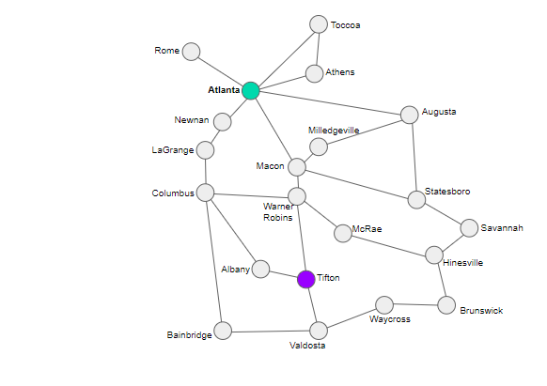
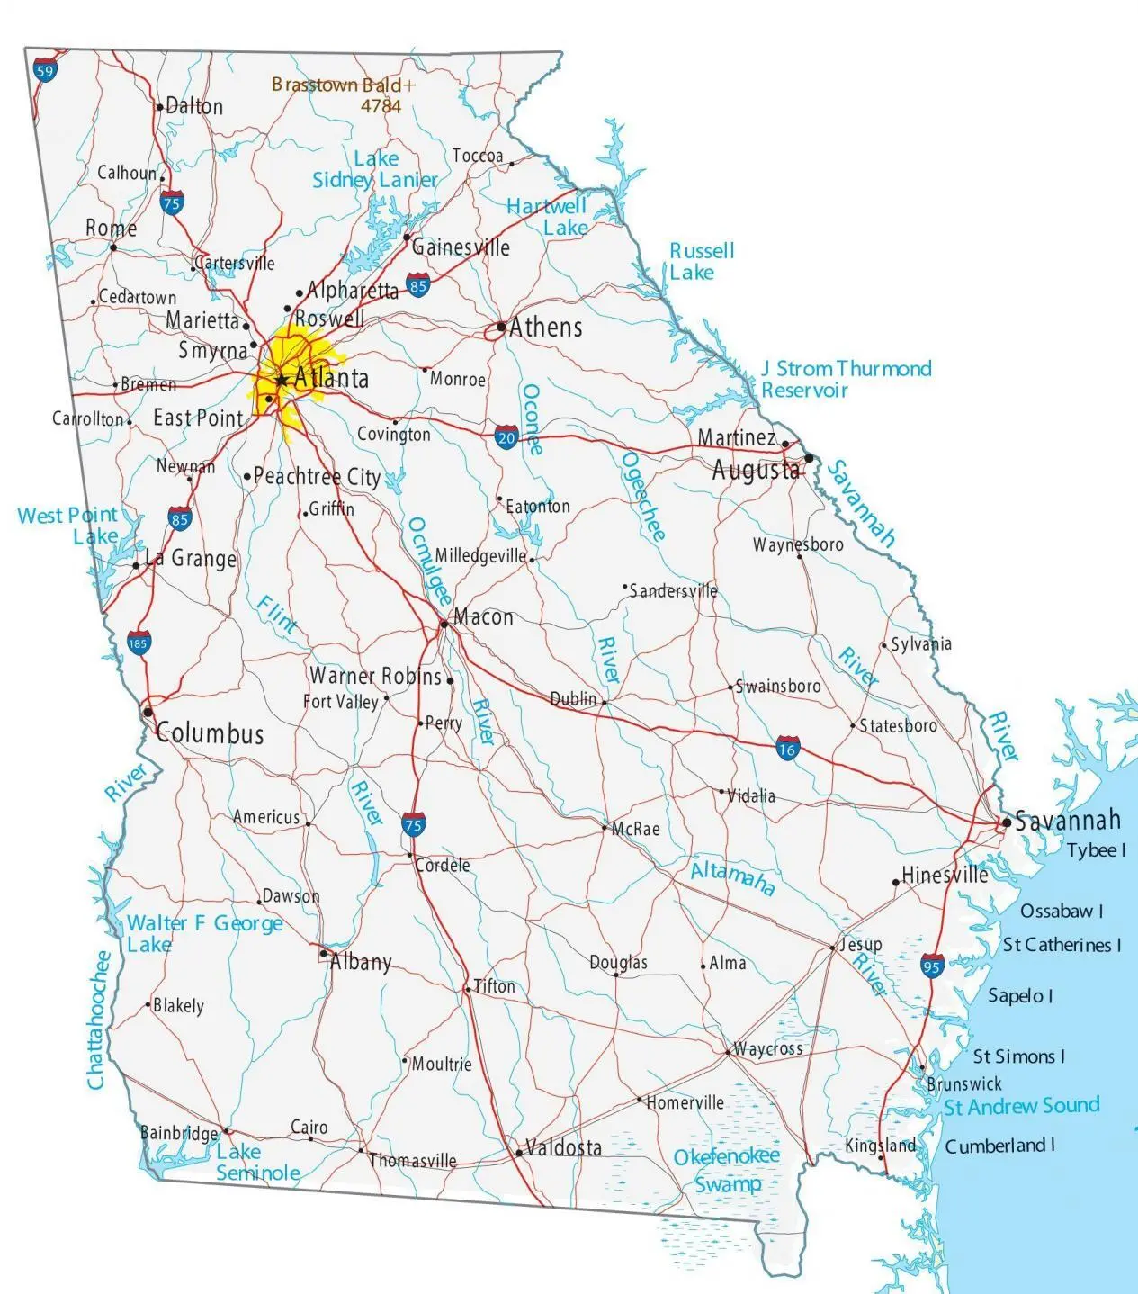
Module 1.5
Route Finding
Living and Working with Artificial Intelligence
Find a route from Atlanta to Tifton
Developed for the AI4GA (Artificial Intelligence for Georgia) project funded by National Science Foundation awards DRL-2049029 and DRL-2048502.
This work is licensed under the Creative Commons. Attribution-NonComercial-ShareAlike 4.0 International License. https://creativecommons.org/licenses/by-nc-sa/4.0/

Slide 8
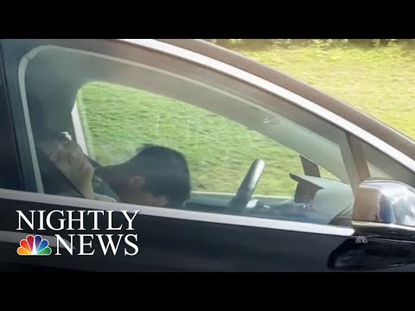
Module 1.6, Case Study #1:
Sleeping Drivers in Self-Driving Cars
Living and Working with Artificial Intelligence
Developed for the AI4GA (Artificial Intelligence for Georgia) project funded by National Science Foundation awards DRL-2049029 and DRL-2048502.
This work is licensed under the Creative Commons. Attribution-NonComercial-ShareAlike 4.0 International License. https://creativecommons.org/licenses/by-nc-sa/4.0/

Slide 9
Module 1.6, Case Study #1:
Sleeping Drivers in Self-Driving Cars
Living and Working with Artificial Intelligence
Student Activity Slides
Developed for the AI4GA (Artificial Intelligence for Georgia) project funded by National Science Foundation awards DRL-2049029 and DRL-2048502.
This work is licensed under the Creative Commons. Attribution-NonComercial-ShareAlike 4.0 International License. https://creativecommons.org/licenses/by-nc-sa/4.0/

Slide 10
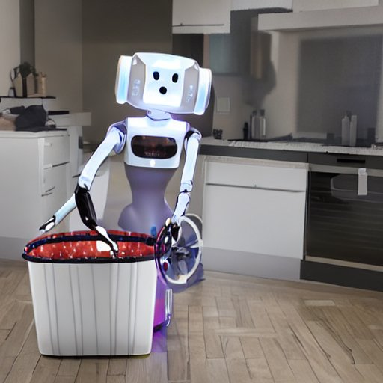
Module 1.7
Mini-Project: Build Your Own Robot
Living and Working with Artificial Intelligence
Created by Sharonda Haddock with Stable Diffusion
Developed for the AI4GA (Artificial Intelligence for Georgia) project funded by National Science Foundation awards DRL-2049029 and DRL-2048502.
This work is licensed under the Creative Commons. Attribution-NonComercial-ShareAlike 4.0 International License. https://creativecommons.org/licenses/by-nc-sa/4.0/

Slide 11
Module 1.7: Resource
Imagine Your Robot
Living and Working with Artificial Intelligence
Developed for the AI4GA (Artificial Intelligence for Georgia) project funded by National Science Foundation awards DRL-2049029 and DRL-2048502.
This work is licensed under the Creative Commons. Attribution-NonComercial-ShareAlike 4.0 International License. https://creativecommons.org/licenses/by-nc-sa/4.0/

Slide 12
Module 1.7
Mini-Project: Choice Boards
Living and Working with Artificial Intelligence
Inspired by the AI or Not Activity developed by MIT for the AI4GA (Artificial Intelligence for Georgia) project funded by National Science Foundation awards DRL-2049029 and DRL-2048502.
This work is licensed under the Creative Commons. Attribution-NonComercial-ShareAlike 4.0 International License. https://creativecommons.org/licenses/by-nc-sa/4.0/

Slide 13
End of Unit:
AI Vocabulary Concept Review
Living and Working with Artificial Intelligence
Developed for the AI4GA (Artificial Intelligence for Georgia) project funded by National Science Foundation awards DRL-2049029 and DRL-2048502.
This work is licensed under the Creative Commons. Attribution-NonComercial-ShareAlike 4.0 International License. https://creativecommons.org/licenses/by-nc-sa/4.0/

